Slide 1
MIST 6150
Project
By:
Pranay Rai
Pavani Narla
Horacio Santos

Slide 2


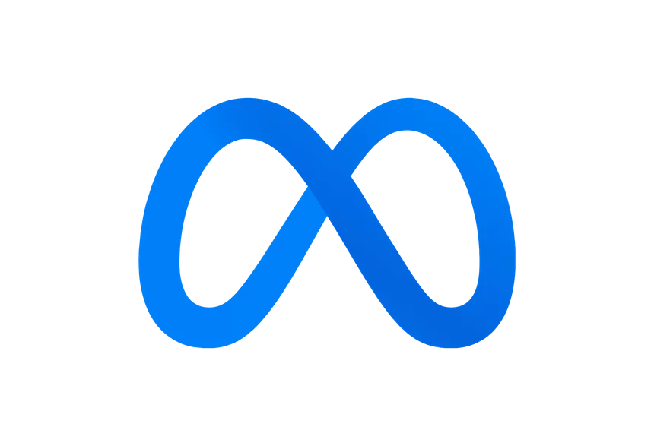
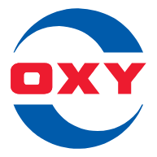
Stocks chosen
Stock Name | Ticker Symbol | Logo | Industry
Palantir Technologies Inc | NYSE: PLTR |  | Big Data
Tesla Inc | NASDAQ: TSLA |  | EV Vehicles
Uber Technologies In | NYSE: UBER |  | Transportation
Meta Platforms Inc | NASDAQ: META |  | Social Media
Occidental Petroleum Corp | NYSE: OXY |  | Oil

Slide 3
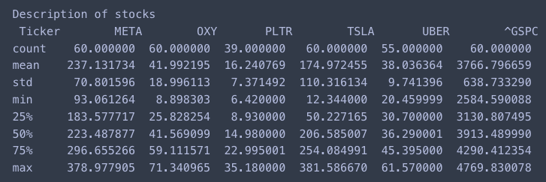
About the Data
.describe()
What it tells us
Standard Deviation
Minimum and Maximum $ from 2019 - 2023
Average and count of data points

Slide 4
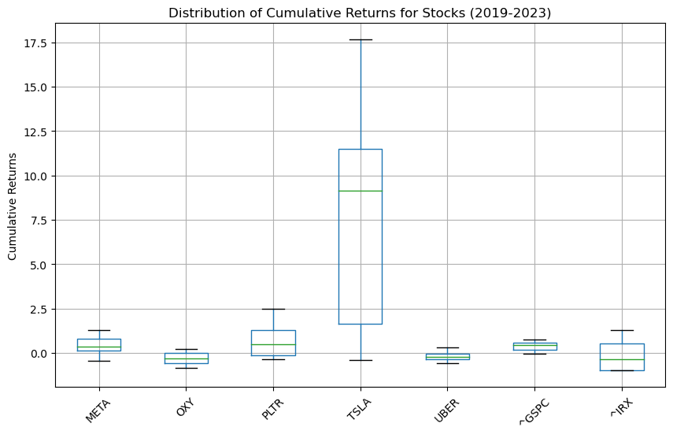
On a Graph

Slide 5
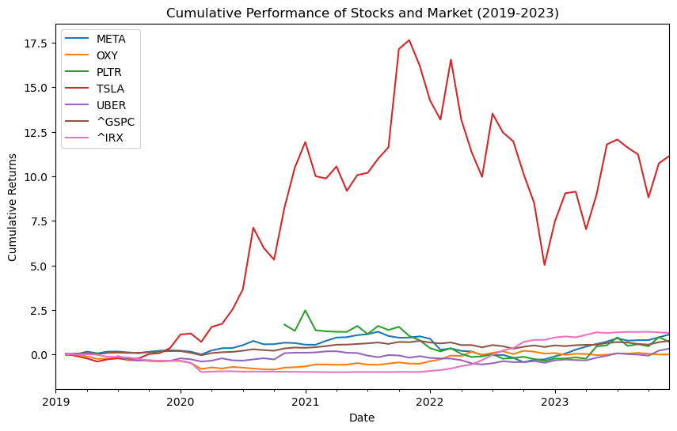
Cumulative Returns

Slide 6
Alpha’s and Beta’s
Stock | Alphas | Betas
Palantir Technologies Inc | 0.0242 | 2.7073
Tesla Inc | 0.0378 | 2.4365
Uber Technologies In | 0.0007 | 1.3101
Meta Platforms Inc | 0.0070 | 1.1522
Occidental Petroleum Corp | 0.0014 | 1.6893
Portfolio | 0.0142 | 1.8591

Slide 7
Alpha’s Test at 0.05% Significance
Stock | Alphas | P-Value
Palantir Technologies Inc | 0.0242 | 0.6638(Not Significant)
Tesla Inc | 0.0378 | 0.1249(Not Significant)
Uber Technologies In | 0.0007 | 0.9654(Not Significant)
Meta Platforms Inc | 0.0070 | 0.5983 (Not Significant)
Occidental Petroleum Corp | 0.0014 | 0.9533 (Not Significant)
Portfolio | 0.2098 | 0.0760 (Not Significant)

Slide 8
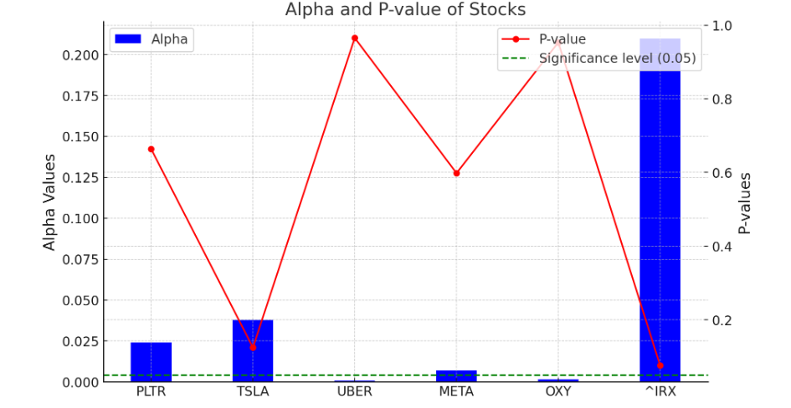
Alpha and P-value Trends:

Slide 9
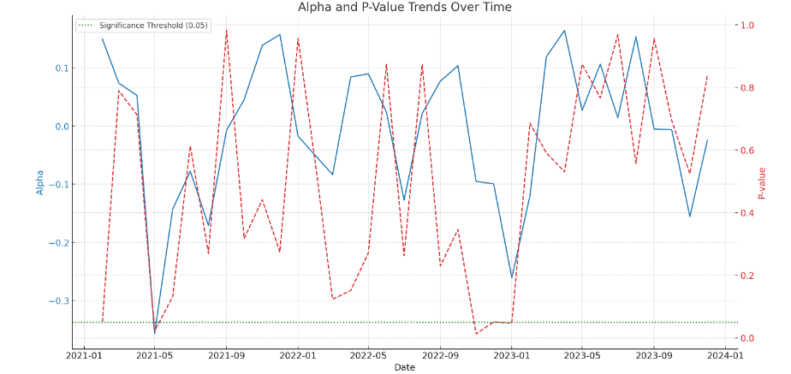
Alpha Trends Over Time:

Slide 10
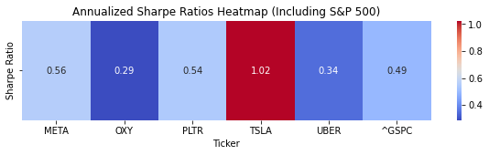
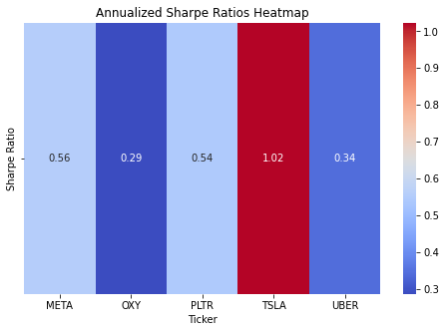
Average Sharpe Ratio
META 0.555763
OXY 0.287295
PLTR 0.544584
TSLA 1.022457
UBER 0.342680
This Sharpe rate ratio has bench mark of 4.99% risk-free- rate and S&P 500
This figure indicates that stocks has perform better than risk-free-rate and some stocks has perform better that S&P 500 which also indicates the stock are volatile.
The Sharpe ratio tells you how much excess return in portfolio receive for the extra volatility of holding a riskier asset as compared to a risk-free asset. A higher Sharpe ratio indicates better risk-adjusted performance.

Slide 11
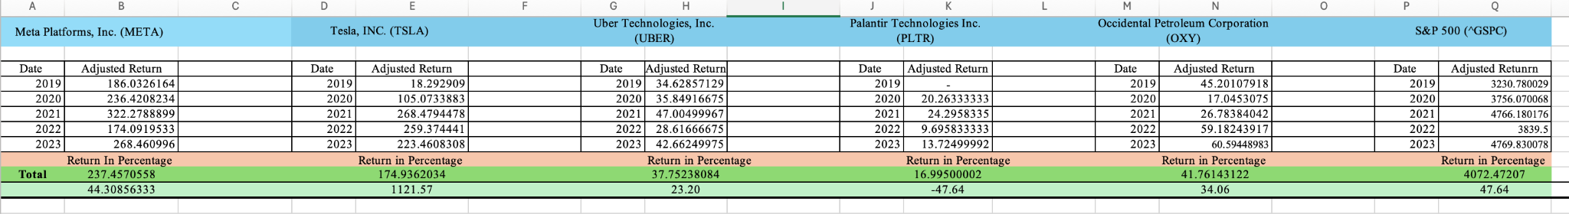
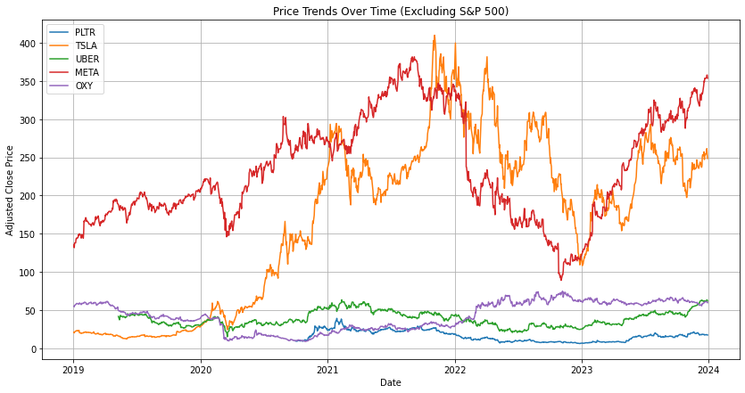
Adjusted Return
META; Average adjusted return; $237 - Total Return in percentage 44%.
TSLA; Average adjusted return; $174 - Total Return in percentage 1121%.
UBER; Average adjusted return; $37 - Total Return in percentage 23%.
PLTR; Average adjusted return; $16 - Total Return in percentage -47%.
OXY; Average adjusted return; $34 - Total Return in percentage 34%.
S&P 500; Average adjusted return; $4072 - Total Return in percentage 47%
From our portfolio only PLTR has underperform in four year horizon.Where META has perform better in EPS but TSLA has better overall Return over five year horizon.

Slide 12
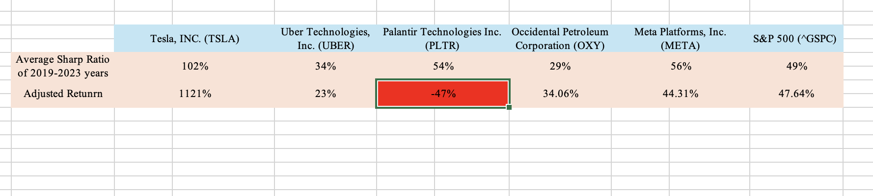
Comparison of Sharpe Ratio & Adjusted Return
Tesla (TSLA) adjusted return of 1121% and average Sharpe ratio of 102%, indicating strong overall performance and very high risk-adjusted returns.
Uber Technologies (UBER) modest adjusted return of 23% and an average Sharpe ratio of 34%, moderate performance.
Palantir Technologies (PLTR) negative adjusted return of -47%, which is a loss over the period. Despite this, the positive average Sharpe ratio of 54% indicates that the volatility or risk level was relatively low compared to the negative performance, or the risk-free rate was low during this period.
Occidental Petroleum Corporation (OXY) has a positive adjusted return of 34.06% and a relatively lower average Sharpe ratio of 29%, suggesting it offered less reward per unit of risk than the higher Sharpe ratio stocks.
Meta Platforms, Inc. (META) also shows a positive performance with an adjusted return of 44.31% and a relatively high average Sharpe ratio of 56%, indicating solid risk-adjusted returns.
S&P 500 (‘^GSPC’), used as a benchmark for overall market performance, shows an adjusted return of 47.64% and an average Sharpe ratio of 49%.

Slide 13
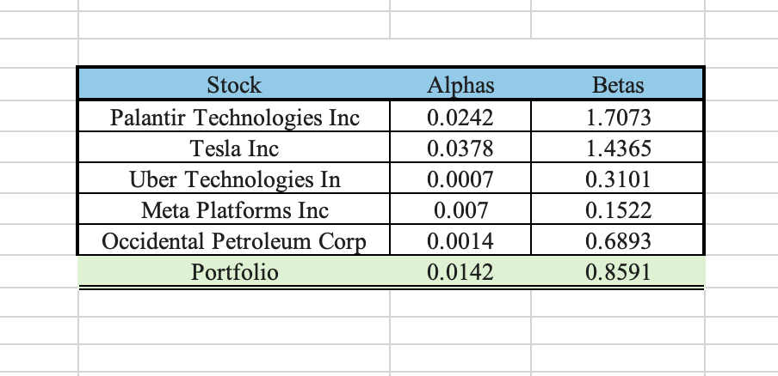
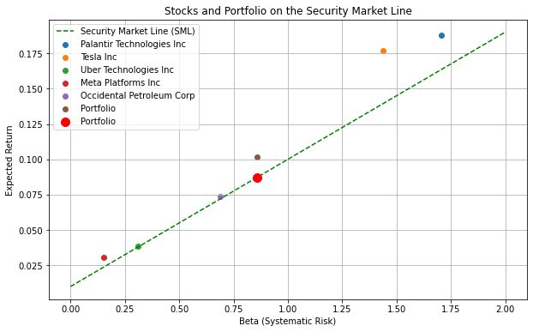
Alpha and Beta - Portfolio
Tesla Inc. and Palantir Technologies Inc have a higher beta, implying they are more volatile.
Uber Technologies Inc and Meta Platforms Inc have lower betas, implying less volatility compared to the market.
Occidental Petroleum Corp and the Portfolio have moderate betas.
The Portfolio, shown as a red dot, seems to be aligned with the SML, suggesting it is properly priced according to CAPM.
Notes:
The portfolio's expected return is consistent with the level of systematic risk (beta) it carries. In other words, the portfolio is giving returns that are expected for its level of risk based on market conditions.
Market Expectations: The alignment suggests that the portfolio is performing exactly as the market would expect, given the risk-free rate and the market risk premium.

Slide 14
Conclusion of Portfolio
Better risk-adjusted performance.
But also extra volatile
In our Adjusted return all of our stocks in portfolio managed to perform close to expectation except PLTR which we lost 50% of our investment over the five year horizon
Sharpe Ratio and Adjusted price, analysis suggest that that the market as a whole provided a reasonable return for the risk taken.
Alpha and Beta to Portfolio, it indicated that our portfolio is well balanced.
The Security Market Line (SML) is a graphical representation of the Capital Asset Pricing Model (CAPM) indicates that our portfolio is well balanced with Market.

Slide 15
Thank you

